Slide 1
Covid -19 Dashboard in Tableau
Fabian Enrique Pedreros

Slide 2
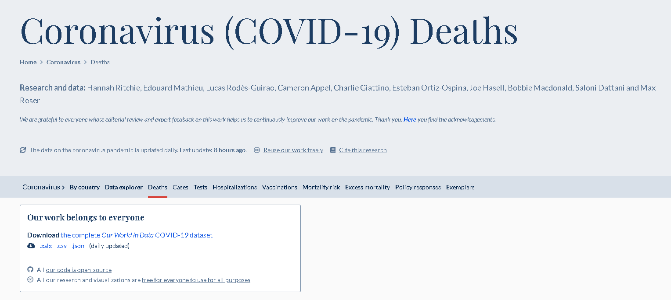
Data context
This tableau dashborad is created with Covid 19 data about cases, deaths, and vaccionations around the world. This data has been taken from https://ourworldindata.org/covid-deaths 01/01/2020 to 03/03/2022

Slide 3
Project context
This project is made to:
Apply five dashboard design concepts taken from Lovelytics in the video Design Secrets for a Non-Designer: Modern Business Dashboard
Apply a requirements gathering tool to understand the needs to create de dashboard
Create an analysis with a modern looking dashboard
Use the data set and data manipulation that has been done in the project SQL_data_exploration_Covid19, a video serie from Alex The Analyst

Slide 4
5 Design concepts
Gather Requirements
Create a template
Use icons and art to your advantage
Choose colors that matter
Fonts

Slide 5

Requirements guidelines
Understand the goal of the Project.
Refine and prioritize business questions.
Determine the audience’s analytical maturity.
Complete a high – level Discovery of the data.
Incorporate en user preferences.
Color, logos, size
Determine the views needed to answer the questions.

Slide 6
Bussines requirements gathering
WHAT?
WHO?
What is the pain point this dashboard aims to address?
Analyze the behavior of the cases, deaths and vaccinations in the world and in Colombia separately.
What requirements have been expressed for this content?
This dashboard should display information about deaths, cases and vaccinations over time. It should display KPI’s like: Total cases, total deaths, total vaccinations, percentage of deaths by population, percentage of cases by population, percentage of vaccinations by population, percentage of deaths by cases. A map where it can see the number of cases, deaths and vaccinations with a tooltip that displays that information. Filters for attributes and countries. Top 5 Countries by metric.
What actions are the users trying to take based on this data?
None.
Who is the target audience for this dashboard?
Data analysts from GitHub, Tableau or LinkedIn.
Primary Business Owner
Fabian Pedreros.
Primary Technical Owner:
Fabian Pedreros.
Audience’s analytical maturity:
Advance understanding of Tableau dashboards.

Slide 7
Technical Requirements gathering
WHAT?
WHERE?
Do you have examples of existing reports that should be replicated?
Yes we have several examples from Tableau Public and the dashboard generated by Alex.
Do you have product specifications, or requirements for what metrics you need?
This metrics have to been shown in millions and percentage.
Will having this data in Tableau replace an existing system?
No.
Is the data needed for this dashboard readily available?
Yes this data has to been taken from the database Covid19, where we have different views of the is data needed.
Which data sources correlate to this dashboard?
Covid19 database.
Where does this data live?
SQL Server.
What is the delivery method for this data?
It is static data, has the information from 01/01/2020 to 03/03/2022

Slide 8
Technical Requirements gathering
WHO?
Who should have access to this data?
Everybody who has access to Tableau Public.
Who should not have access to this data?
None

Slide 9
Summary of requirements
Create an interactive dashboard that analize the Covid 19 data around the world, this can be shared in Tableau Public.
Display information about deaths, cases and vaccinations over time. → Line Chart.
Total cases → BAN
Total deaths → BAN
Total vaccinations → BAN
Percentage of deaths by population → BAN
Percentage of cases by population → BAN
Percentage of vaccinations by population → BAN
Percentage of deaths by cases → BAN
A map where it can see the number of cases, deaths and vaccinations with a tooltip that displays that information. → Map and tooltip
Filters for attributes and countries. → Map as a filter
Top 5 Countries by metric. → Text table or bar graph

Slide 10
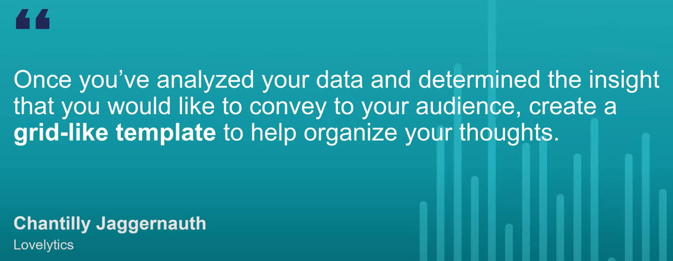
Creating a template

Slide 11

Template guidelnes
Prioritize requirements.
Only use what is important.
Icorporate BAN’s and context.
Use blank text boxes o pan/paper.
Use size and position to show hierarchy.
Begin to think about icons and use of color
Design to a grid.

Slide 12
Modern design areas of focus
Start with a example in mind
Drop shadows.
Simple layout with white space.
Rounded corners.
Incorporate large BAN’s
Design to a grid.

Slide 13
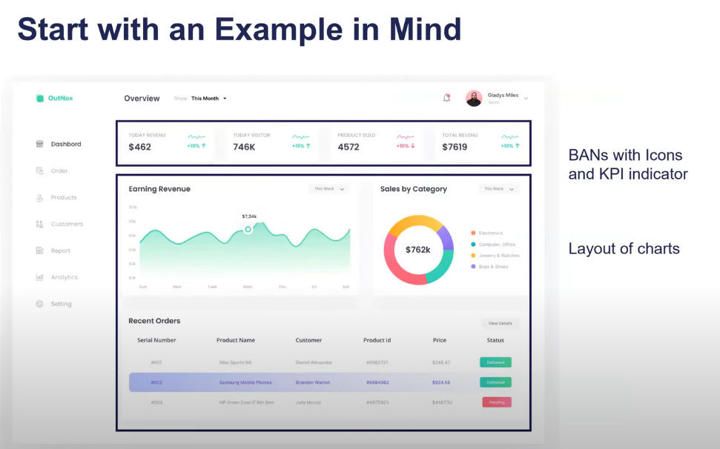
Examples

Slide 14
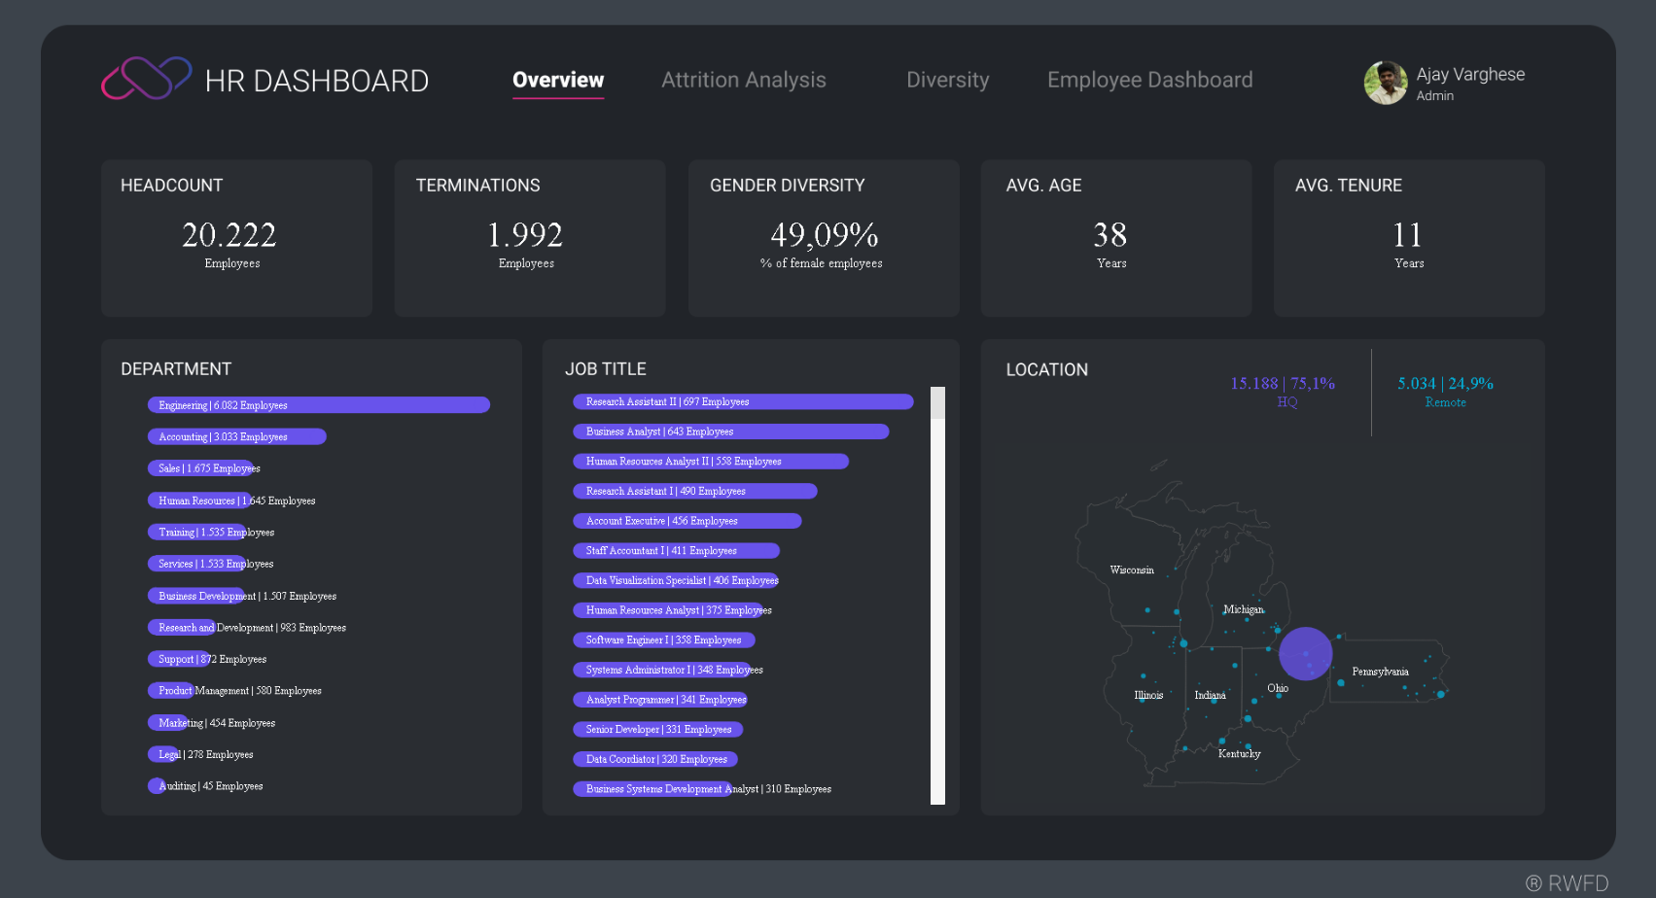
Examples
I like the bans with metrics.

Slide 15
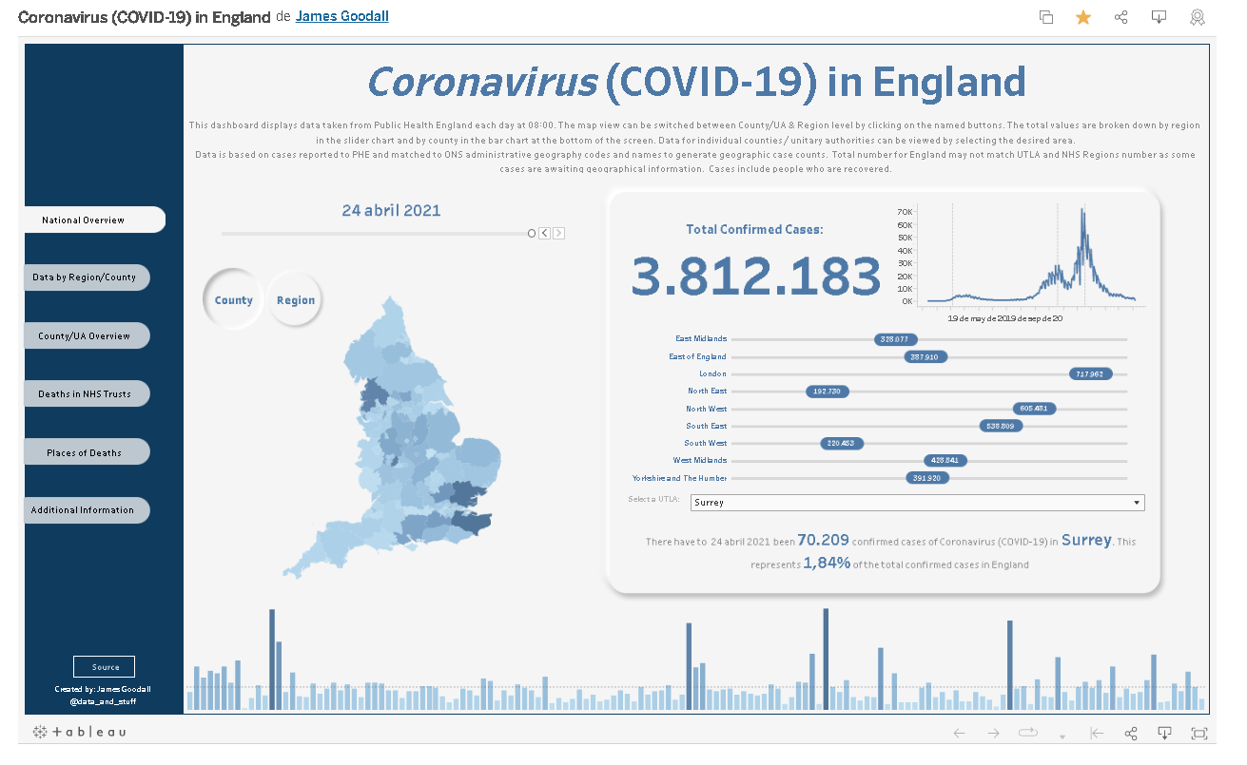
Examples
I like the map at the left side

Slide 16
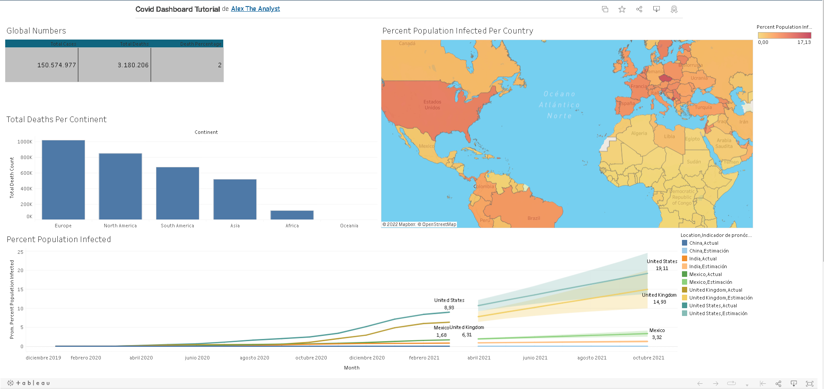
Examples
I like the map with the heat colors
I like the use of barchart to show the top five

Slide 17
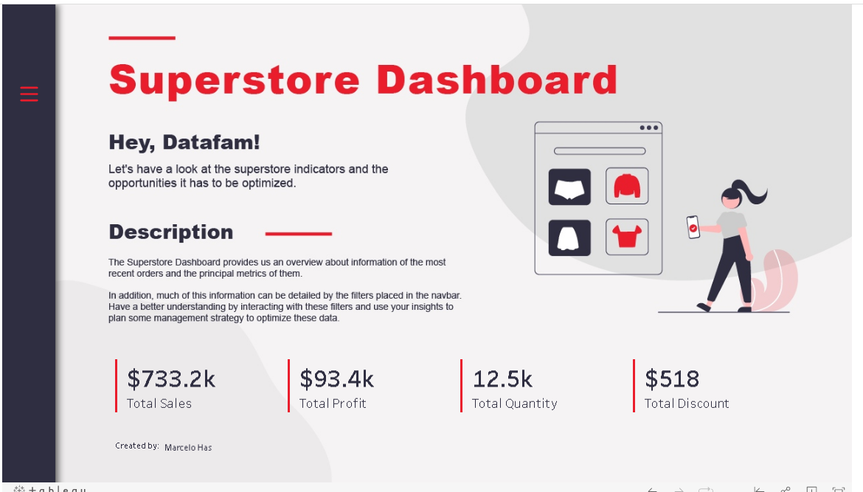
Examples
I like the use of colors and images
I like the BAN`s design

Slide 18
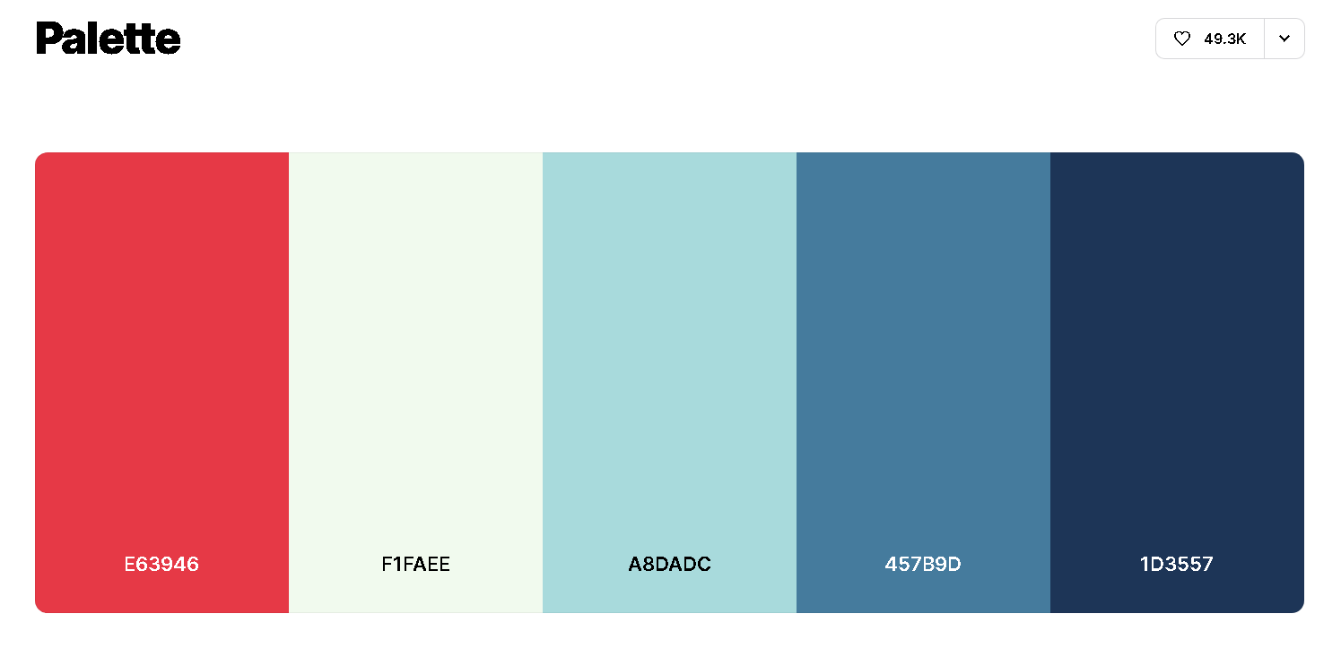
Colors

Slide 19
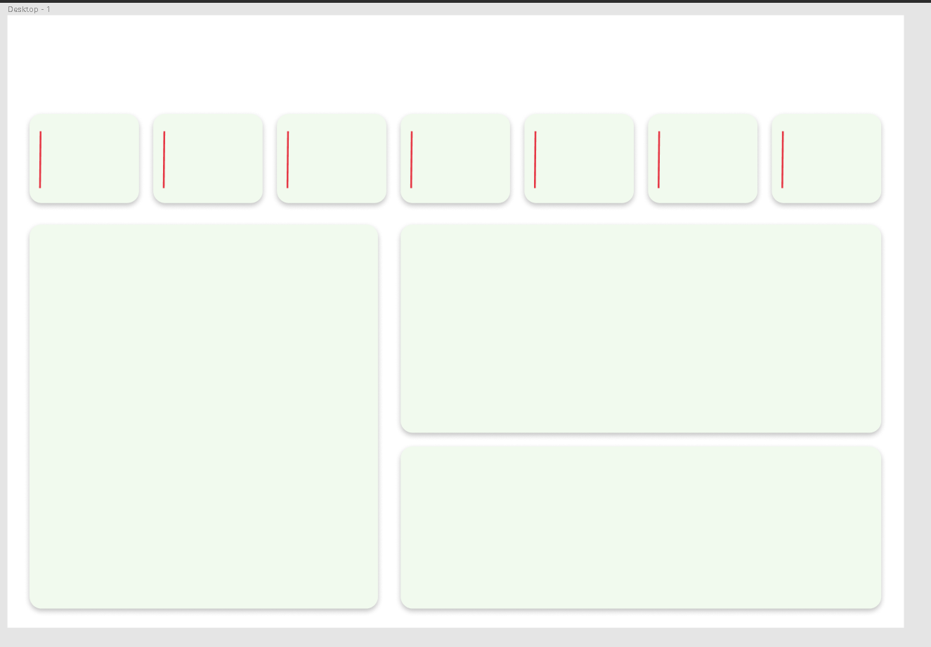
Template creation

Slide 20
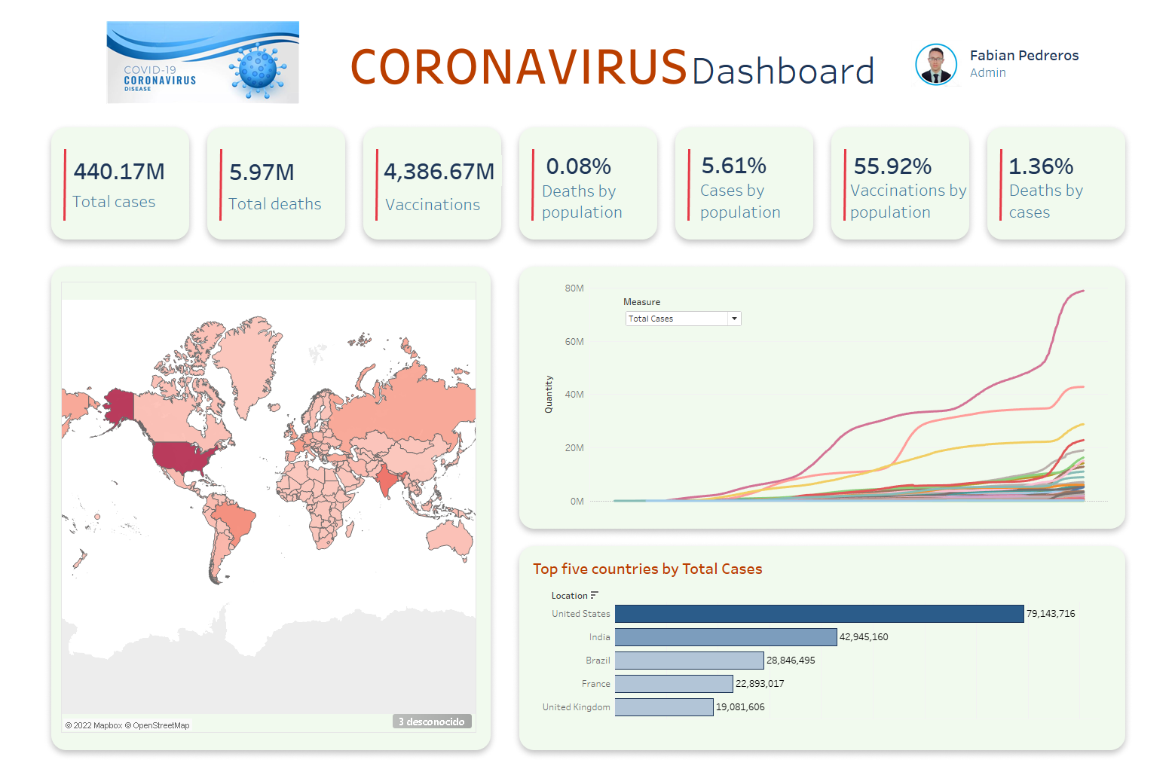
Dashboard creation

Slide 21
Thanks!

